Slide 1
Causal Inference 101
When correlation does imply causation
Ehud Karavani @ Advanced csls seminar
Notes:
A lot of text so the presentation could be standalone for later review.
Feel free to question

Slide 2
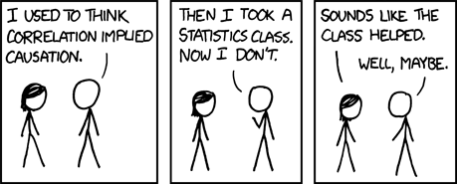
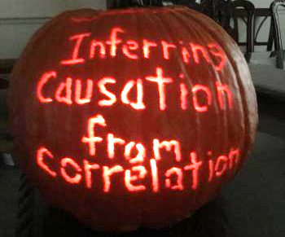
Notes:
We were told not to confuse correlation and causation.
But I hope that by the end of the talk we would know why and when we can conclude cause-effect relationship

Slide 3
Humans Are Causal Thinkers
Homo-sapiens are excellent causal thinkers.
We gain causal conclusions from patterns in data, i.e. correlations.
However we taught ourselves to be very careful about it when gaining insights from data.
… And for a good reason.
Notes:
Our story begins
We see things happening together and we can conclude cause and effect.

Slide 4
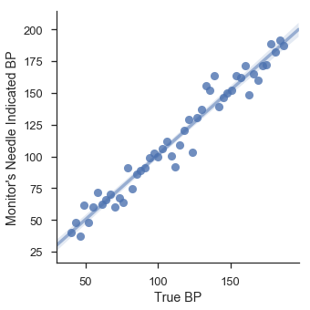
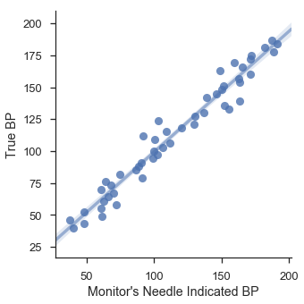
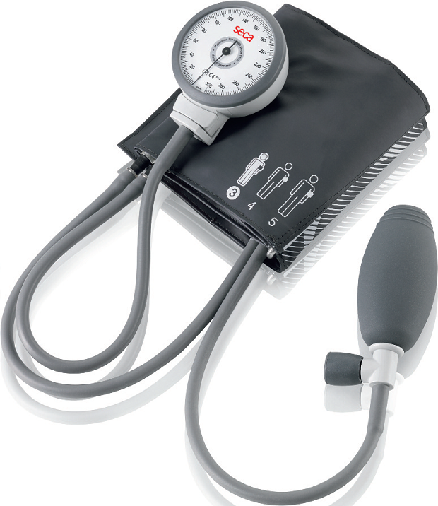
“Data Are Dumb” – Judea Pearl
Data can only show patterns of association.
Tinkering with the monitor’s needle will not change your blood pressure!
Notes:
BP monitor. With some noisy measurement.
BP raising so does the needle indication.
The relation is invariant to direction. That’s why we can transpose (Galton)
Holding the needle in the BP monitor will not keep BP constant.

Slide 5
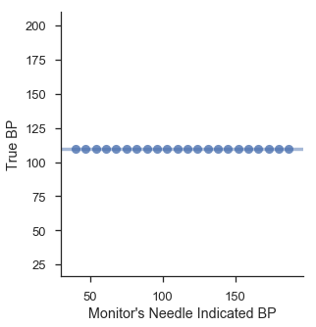
“Data Are Dumb” – Judea Pearl
Data can only show patterns of association.
Tinkering with the monitor’s needle will not change your blood pressure!
How blood pressure truly behaves when intervening with monitor’s needle:
Notes:
Blood pressure as function of moving the needle

Slide 6
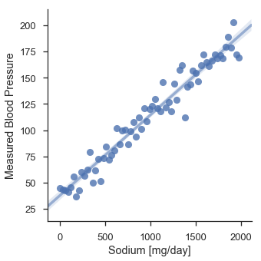
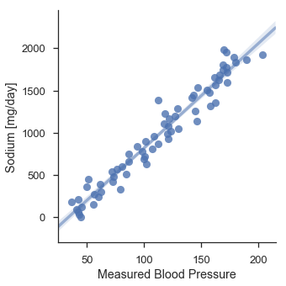
“Data Are Dumb” – Judea Pearl
Data can only show patterns of association.
Increasing blood pressure won’t increase your sodium intake!
Notes:
More serious example: increasing blood pressure won’t increase your sodium intake!

Slide 7
“Data Are Dumb” – Judea Pearl
Fun Fact:
This is called sphygmomanometer
Data can only show patterns of association.
Increasing blood pressure won’t increase your sodium intake!
Notes:
Fun fact!

Slide 8
Randomized Control Trial
The gold standard for concluding a causal effect.
How can we assert it was the sodium increasing blood pressure?
The procedure:
Gather many people.
A coin is tossed to determine if a participant is in control or treatment group. Treatment group get treated. Controls are provided with placebo.
Notes:
How can we say it was the sodium and not the atmosphere in the nurse’s room?

Slide 9
Randomized Control Trial
The gold standard for concluding a causal effect.
Randomization causes no other feature to determine group assignment or to be associated with blood pressure.
For example: Being young reduces blood pressure. Randomization assures age distribution will the same in each group so, on average, age won’t account for changes in blood pressure because similar amount of young people will be in both groups.
So the change in outcome is only due to the change treatment.
Correlation is causation.
Notes:
Same distribution = unbiased sample.
All other covariates (age, sex…) are, by randomization, will not be associated with the outcome – they will be similarly distributed between groups so their effect on the outcome will cancel out.

Slide 10
Randomized Control Trial
RCTs are not always feasible:
Ethics (smoking causes cancer?)
Cost (effect of space on gene expression)
Time (effect on fertility?)
Generalization (unrealistic experiment setting)
On contrast – data is abundant
Can it be utilized for causal insights?
Notes:
Problem is RCT not always feasible.
Fertility – men have 50-60 years of fertility.
Generalization – medicine with side effects, will be discarded by reg users, is it half as good? Is it worse?

Slide 11
Causal Effect from Observed Datasets
Observed dataset – data is taken from usual day-to-day activity.
In order to infer causal conclusions we would need to either
Assume\condition our dataset
Enforce a generative data process on the environment
No state-of-the-art neural net architecture to our aid.
The Secret was within us all along!

Slide 12
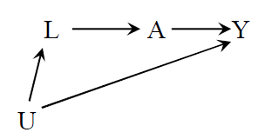
Two Schools of Causal Inference
Condition the dataset
Assume on the environment
Implicit model: Assume you can emulate an RCT from the dataset.
No causation without manipulation.
Harness conditional statistics.
Causal Inference for Statistics, Social, and Biomedical Sciences [2015’]
Explicit model: Assume a generative process in the form of a graph (causal diagram).
Everything is possible cause.
Do-calculus. Graph methods.
Causality: Models, Reasoning and Inference [2nd edition 2009’]
Notes:
To make causal conclusion we would need to make assumptions or enforce a generative causal model we believe represent how data was generated. Those represent the two known schools in current causal inference field – Pearl vs Rubin.

Slide 13
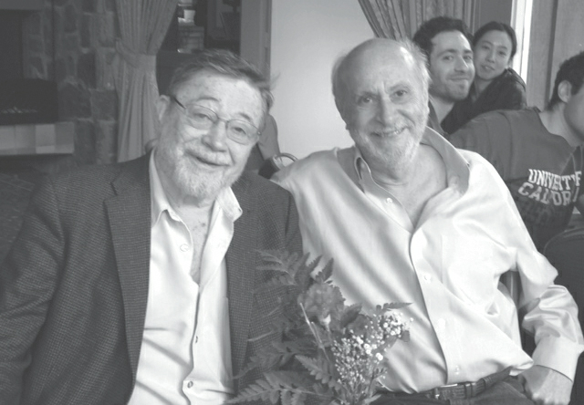
Two Schools of Causal Inference
Condition the dataset
Assume on the environment
Implicit model: Assume you can emulate an RCT from the dataset.
No causation without manipulation.
Harness conditional statistics.
Causal Inference for Statistics, Social, and Biomedical Sciences [2015’]
Explicit model: Assume a generative process in the form of a graph (causal diagram).
Everything is possible cause.
Do-calculus. Graph methods.
Causality: Models, Reasoning and Inference [2nd edition 2009’]
Photo by Grace Hyun Kim, taken from The Book of Why by Pearl

Slide 14
Two Schools of Causal Inference
Condition the dataset
Assume on the environment
Implicit model: Assume you can emulate an RCT from the dataset.
No causation without manipulation.
Harness conditional statistics.
Causal Inference for Statistics, Social, and Biomedical Sciences [2015’]
Explicit model: Assume a generative process in the form of a graph (causal diagram).
Everything is possible cause.
Do-calculus. Graph methods.
Causality: Models, Reasoning and Inference [2nd edition 2009’]
Photo by Grace Hyun Kim, taken from The Book of Why by Pearl
Notes:
Pearl pionneered Bayesian networks and computational graphs, so he’s model is a generative one.

Slide 15
Two Schools of Causal Inference
THIS TALK
Condition the dataset
Assume on the environment
Implicit model: Assume you can emulate an RCT from the dataset.
No causation without manipulation.
Harness conditional statistics.
Causal Inference for Statistics, Social, and Biomedical Sciences [2015’]
Explicit model: Assume a generative process in the form of a graph (causal diagram).
Everything is possible cause.
Do-calculus. Graph methods.
Causality: Models, Reasoning and Inference [2nd edition 2009’]
THIS GUY
Notes:
Rubin’s Causal Model

Slide 16
Counterfactuals
Potential outcomes - What would have happen if?
Impossible to observe (unless you travel between multiple universes)
Notes:
First thing is to invoke counterfactual thinking. Why it is impossible to observe. Although we predict it daily (when we do planning).

Slide 17
Rubin’s Causal Model - Notation
$X$ – Covariates (variables, features…)
$Y$ – Outcome (label, target…)
$A$ – Treatment Assignment
Assumed binary throughout – treated or control.
$Y_{i}^{A=a}$ – Potential outcome
The outcome of individual $i$ if she were to have treatment $a$.
Notes:
Mathematical language to describe counterfactuals.
X, Y like regular ML tasks. Special variable A.
Now we go utilize 100 years of statistics to our cause.

Slide 18
Defining Effect
Additive Effect
Multiplicative Effect
Odds Ratio
$𝔼\left[Y^{1}\right]−𝔼\left[Y^{0}\right]$
${𝔼\left[Y^{1}\right]}/{𝔼\left[Y^{0}\right]}$
${\frac{\text{Pr}\left[Y^{1}=1\right]}{\text{Pr}\left[Y^{1}=0\right]}}/{\frac{\text{Pr}\left[Y^{0}=1\right]}{\text{Pr}\left[Y^{0}=1\right]}}$
for binary $Y$: $𝔼=\text{Pr}$
$𝔼_{i}\left[Y_{i}^{1}\right]$ - if we were to give everyone the treatment
$𝔼_{i}\left[Y_{i}^{0}\right]$ - if we were to deny everyone from the treatment
Notes:
An imaginary world were we would either give the treatment to everyone, or deny the treatment from everyone.
RCTs can’t answer that, they are just a proxy (estimation) for that question.
This allows unrealistic yet useful language (just like non-Euclidean geometry, for example).

Slide 19
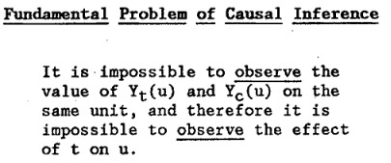
The Fundamental Problem of Causal Inference (Holland 86’)
You cannot observe both $Y_{i}^{1}$ and $Y_{i}^{0}$ for any individual $i$
Notes:
So we can’t ask what would’ve happen if everyone would get and not-get.
Like quantum, we’re in some superposition (hypothetical world) until we need to actually decide whether to give or not. Once we do that we can observe only one course of reality.

Slide 20
The Fundamental Problem of Causal Inference
Half of the needed values are missing
Participant | $$A$$ | $$Y^{1}$$ | $$Y^{0}$$
Apu | 1 | 1 | ?
Bart | 0 | ? | 0
Carl | 1 | 1 | ?
Dr. Hibbert | 1 | 0 | ?
Edna | 0 | ? | 1
Flanders | 0 | ? | 0

Slide 21
“Effect” from Observational Data
What we can do is calculate the observed quantity:
$$𝔼\left[Y | A=1\right]−𝔼\left[Y | A=0\right]$$
Participant | $$A$$ | $$Y$$
Apu | 1 | 1
Bart | 1 | 0
Carl | 1 | 1
Dr. Hibbert | 0 | 0
Edna | 0 | 1
Flanders | 0 | 0
Notes:
E[Y|A=1] is basically “take all off those who were treated and calculate the mean of their outcome”.
This is what we can measure in an RCT.

Slide 22
“Effect” from Observational Data
What we can do is calculate the observed quantity:
$$𝔼\left[Y | A=1\right]−𝔼\left[Y | A=0\right]$$
Participant | $$A$$ | $$Y$$
Apu | 1 | 1
Bart | 1 | 0
Carl | 1 | 1
Dr. Hibbert | 0 | 0
Edna | 0 | 1
Flanders | 0 | 0
Notes:
E[Y|A=1] is basically “take all off those who were treated and calculate the mean of their outcome”.
This is what we can measure in an RCT.

Slide 23
“Effect” from Observational Data
What we can do is calculate the observed quantity:
$$𝔼\left[Y | A=1\right]−𝔼\left[Y | A=0\right]$$
In general:
$$𝔼\left[Y^{A=1}\right]−𝔼\left[Y^{A=0}\right]≠𝔼\left[Y | A=1\right]−𝔼\left[Y | A=0\right]$$
This is when correlation is not causation.
Notes:
E[Y|A=1] is basically “take all off those who were treated and calculate the mean of their outcome”.
This is what we can measure in an RCT.

Slide 24
Identifiability of Causal Effect
Equality holds
$$𝔼\left[Y^{A=1}\right]−𝔼\left[Y^{A=0}\right]=𝔼\left[Y | A=1\right]−𝔼\left[Y | A=0\right]$$
Under three conditions/assumptions:
Consistency
Positivity
Exchangeability
To conclude causal effect from observed data we must accept these.
Up to the researcher to check/contemplate whether they hold in each case.
Notes:
When can we look at data and conclude a true causal effect? “Identify causal effect”.

Slide 25
Positivity (Identifiability Condition 1)
$$\text{Pr}\left[A=a | X=x\right]>0 ∀a,x$$
Everyone must have some chance for getting the treatment.
The alternative: assign all individuals to either $A=1$ or $A=0$.
If no females $\left(X\right)$ were assigned the treatment - it would be impossible to infer the treatment effect on them.
AKA covariate overlap or common support
Notes:
Needed for inference.
Can be violated from statistical reasons (sampling error) or structural causes (such individuals are never treated)
The two groups should have similar statistical features.

Slide 26
Consistency (Identifiability Condition 2)
$$Y_{i}^{a}=Y_{i} ∀i \text{s}\text{.}\text{t}\text{.} A_{i}=a$$
If an individual $i$ happens to have $A_{i}=a$, we will observed the counterfactual $Y_{i}^{A=a}$.
Participant | $$A$$ | $$Y$$
Apu | 1 | 1
Bart | 1 | 0
Carl | 1 | 1
Dr. Hibbert | 0 | 0
Edna | 0 | 1
Flanders | 0 | 0
Participant | $$A$$ | $$Y^{1}$$ | $$Y^{0}$$
Apu | 1 | 1 | ?
Bart | 1 | 0 | ?
Carl | 1 | 1 | ?
Dr. Hibbert | 0 | ? | 0
Edna | 0 | ? | 1
Flanders | 0 | ? | 0
Notes:
The connection between the hypothetical world to real life.
Consistency is an assumption.
Expected to hold if
Treatment is well defined
No causal interference (one’s outcome is not affected by another’s)

Slide 27
Exchangeability (Identifiability Condition 3)
$$Y^{a}⊥A|X ∀a \\ ⇓ \\ \text{Pr}\left[Y^{A=1}=y | A=1,X=x\right]=\text{Pr}\left[Y^{A=1}=y | A=0,X=x\right]=\text{Pr}\left[Y^{A=1}=y | X=x\right]$$
If within each treatment group the distribution of $Y^{1},Y^{0}$ is the same, then it promises that the differences we observe between $Y^{1}$ and $Y^{0}$ are due to $a=1$.
The groups are comparable: what would’ve happen if the treated subjects if they had not gotten treatment. Would the outcome be the same as for who in reality did not receive the treatment?
Also called ignorability – the treatment can be ignore – it’s a non-factor.
Notes:
Take individuals that were treated. Imagine what would’ve happen if they haven’t got the treatment. Would the outcome be the same as the for those who in reality did not receive. Then there is no other thing affecting the outcome beside the treatment.
Whatever you received in reality does not affect the what would’ve happen if you received. So the assigning does not matter (can be ignored).
Treatment does not predict the outcome, so P(Y|A,X)=P(Y|X) – treatment is ignored.
This same distribution in each treatment group is exactly what randomization did in RCT for covariates, but here we extend it to also hold for potential outcomes (namely, not just the covariates).

Slide 28
Derivation of Causal Effect from Observed Conditional
Given identifiability:
$$𝔼\left[Y^{a}\right]\overset{∗}{=}\sum_{x}{𝔼\left[Y^{a}|X=x\right]⋅\text{Pr}\left[X=x\right]} \\ \overset{∗∗}{=}\sum_{x}{𝔼\left[Y^{a}|A=a,X=x\right]⋅\text{Pr}\left[X=x\right]} \\ \overset{∗∗∗}{=}\sum_{x}{𝔼\left[Y|A=a,X=x\right]⋅\text{Pr}\left[X=x\right]} \\ \overset{∗}{=}𝔼\left[Y|A=a\right]$$
* Total probability. **Exchangeability. *** Consistency
Counterfactual
Observed
Notes:
Hypothetical on the one side of the equation. Measured from the data on the other.

Slide 29
Randomized Control Trial - Revisited
The procedure:
A coin¹ is tossed to determine if a subject is in control or treatment group². Treatment group get treated. Controls are provided with placebo³.
¹Positivity
²Exchangeability
³Consistency
So taking the conditional $𝔼\left[Y | A=1\right]−𝔼\left[Y | A=0\right]$ reveals the true causal effect!
Randomizing treatment assignment not only de-associate covariates from the outcome, but also provide a random subset of (i.e. same distribution of) $Y^{1}$ and $Y^{0}$ in each group.
Notes:
Placebo effect: if E[Y|A=1] = E[Y^1] + excitement so E[Y^a] \neq E[Y|A=a] – no consistency (that’s why we placebo the controls, so we’d have the effect of “excitement” for them as well, and it would cancel out when we compare E[Y|A=0] and E[Y|A=0]).

Slide 30
Emulating Target Trial [Hernan & Robins 16’]
Causal inference is (mostly) about emulating a randomized control trial from observational data:
Each causal effect has a hypothetical RCT that can quantify it.
Many challenges in doing that, we will touch on confounding:
A covariate affecting both the outcome and the treatment assignment. Change in outcome may be a “mix” of the contributed effect of the covariate and the effect due to the treatment.
Notes:
Embedding the observational data into an RCT.
Building cohort – require defining a study design (out of scope).

Slide 31
Matching
Let $D\left(x_{i},x_{j}\right)$ be a metric over $𝒳$.
For each treated subject $i$ match a control subject $i^{∗}$ s.t. $i^{∗}=\arg{\min_{j}{D\left(x_{i},x_{j}\right)}}$.
Let $M$ be the matched dataset ${\left\{\left(i_{k},i_{k}^{∗}\right)\right\}}_{k=1}^{n}$.
Calculate the effect:
$$𝔼\left[Y^{1}\right]−𝔼\left[Y^{0}\right]=\frac{1}{n}\sum_{k=1}^{n}{y_{i_{k}}−y_{i_{k}^{∗}}}$$
Since $x_{i_{k}}≈x_{i_{k}^{∗}} ∀k$, we know the difference between $y_{i_{k}}$ and $y_{i_{k}^{∗}}$ is only due to $i_{k}$ being treated and $i_{k}^{∗}$ being in control.
Positivity can be detected when $\arg{\min_{j}{D\left(x_{i},x_{j}\right)}}$ is large.
Notes:
Matching types: 1-to-1, many-to-1, all-below-threshold…
Can discard samples with no matching (caliper) – lack of positivity.

Slide 32
Matching (An Example)
Treated
Control
Notes:
We have a population with different ages and sexes.
Positivity (fish)
Control group being usually larger (many Lisas)

Slide 33
Matching (An Example)
Treated
Control
Notes:
We have a population with different ages (young old elder) and sexes (male female).
Real data will be of much higher dimensionality.

Slide 34
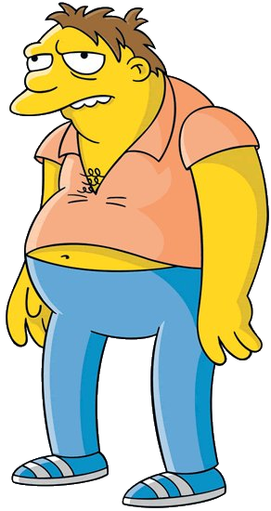
Inverse Probability Weighting
Consider the case where we have multiple control matches to a single treated.
Picking one in random
make a noise the estimate (what if we pick an outlier?)
Noise which can be mitigated over multiple matching, i.e., multiple analyses, which can be computationally demanding.
Discards much of the data.
Notes:
All these matches to Homer in age and sex. But what if one is an outlier? How can we mitigate its effect on the analysis?

Slide 35
Inverse Probability Weighting

Slide 36
Inverse Probability Weighting
$$w_{i}=\frac{1}{\text{Pr}\left[A=A_{i} | X=X_{i}\right]} ∀i$$
In our case, we have total of 5 adult male participants. One is treated.
$\text{Pr}\left[A=1 | X=\left\{\text{adult}, \text{male}\right\}\right]=1/5$, $\text{Pr}\left[A=0 | X=\left\{\text{adult}, \text{male}\right\}\right]=4/5$
$$\frac{5}{1}=5$$
$$\frac{5}{4}=1.25$$
$$\frac{5}{4}=1.25$$
$$\frac{5}{4}=1.25$$
$$\frac{5}{4}=1.25$$
Notes:
Positivity to avoid denominator being zero.

Slide 37
Inverse Probability Weighting
$\text{Pr}\left[A | X\right]$ is called propensity
$$w_{i}=\frac{1}{\text{Pr}\left[A=A_{i} | X=X_{i}\right]} ∀i$$
In our case, we have total of 5 adult male participants. One is treated.
$\text{Pr}\left[A=1 | X=\left\{\text{adult}, \text{male}\right\}\right]=1/5$, $\text{Pr}\left[A=0 | X=\left\{\text{adult}, \text{male}\right\}\right]=4/5$
$$\frac{5}{1}=5$$
$$\frac{5}{4}=1.25$$
$$\frac{5}{4}=1.25$$
$$\frac{5}{4}=1.25$$
$$\frac{5}{4}=1.25$$
Notes:
Propensity – how much an individual is inclined to be treated.
Should be aware of model’s probability calibration since we are modeling actual probabilities.

Slide 38
Inverse Probability Weighting
Creates a pseudo population:
Of size of $2n$: where $n$ are treated and $n$ are controlled.
$$\frac{5}{1}=5$$
$$\frac{5}{4}=1.25$$
$$\frac{5}{4}=1.25$$
$$\frac{5}{4}=1.25$$
$$\frac{5}{4}=1.25$$
Notes:
This pseudo population resides in the magic realm of unrealistic counterfactuals.

Slide 39
Inverse Probability Weighting
Creates a pseudo population:
Of size of $2n$: where $n$ are treated and $n$ are controlled.
Unconfounded (everyone are equally likely to be treated).
Balance between groups.
Agent Smithson
Hybrid – a quarter of each
Notes:
This pseudo population resides in the magic realm of unrealistic counterfactuals.
In original pop some where more/less likely to be treated based on their covariates, now they are equally likely: Pr[A|X]=0.5

Slide 40
Inverse Probability Weighting
Creates a pseudo population:
Of size of $2n$: where $n$ are treated and $n$ are controlled.
Unconfounded (everyone are equally likely to be treated).
Balance between groups.
Potential outcome estimator:
$$𝔼\left[Y^{a}\right]=\frac{1}{\sum_{i:A_{i}=a}{w_{i}}}\sum_{i:A_{i}=a}{w_{i}y_{i}}$$
Horvitz-Thomson estimator
Notes:
Estimating unbiased potential outcome using weighted average.

Slide 41
Simpson’s Paradox
Not a true philosophical paradox, simply an unintuitive result.
It occurs when the overall data (e.g., people) shows one trend, but, separately, the stratified groups (e.g., females/males) shows the opposite trend.

Slide 42
Simpson’s Paradox
Case study:
A real-life medical study comparing success rates of two treatments for kidney stones.
Treatment A: open surgery
Treatment B: less-invasive procedure
Data from Charig et. al. 86’

Slide 43
Simpson’s Paradox
Treatment | A | B
 | 273/350 = 78.0% | 289/350 = 82.5%
Equal group sizes. Treatment B is better.
Notes:
Equal group size: 350.
Treatment B is better…

Slide 44
Simpson’s Paradox
Treatment Stone size | A | B
Both sizes | 273/350 = 78.0% | 289/350 = 82.5%
Small | 93.1% | 86.67%
Large | 73.0% | 68.75%
How come Treatment A is better in both small and large stones, but worse overall?
Notes:
… or is it?

Slide 45
Simpson’s Paradox
Treatment Stone size | A | B
Both sizes | 273/350 = 78.0% | 289/350 = 82.5%
Small | 81/87 = 93.1% | 234/270 = 86.67%
Large | 192/263 = 73.0% | 55/80 = 68.75%
Unequal distribution of severe/easy cases among treatments.
Notes:
Unequal distribution of good/bad cases among treatment.
Fractions don’t always comply to our intuition: A/B>a/b and C/D>c/d does not follow (A+C)/(B+D) > (a+c)/(b+d)

Slide 46
Simpson’s Paradox
Treatment Stone size | A | B
Both sizes | 273/350 = 78.0% | 289/350 = 82.5%
Small | 81/87 = 93.1% | 234/270 = 86.67%
Large | 192/263 = 73.0% | 55/80 = 68.75%
Stone size is a confounder: it affects both the outcome (bigger stones has less chance for success) and the treatment assignment (bigger stones might not be feasible for the non-invasive treatment, open surgery might be “an overkill” for small stones) – Treatment B had unfairly more easy cases, thus the higher success rate

Slide 47
Visualizing how IPW can mitigate the confounding effect.

Slide 48
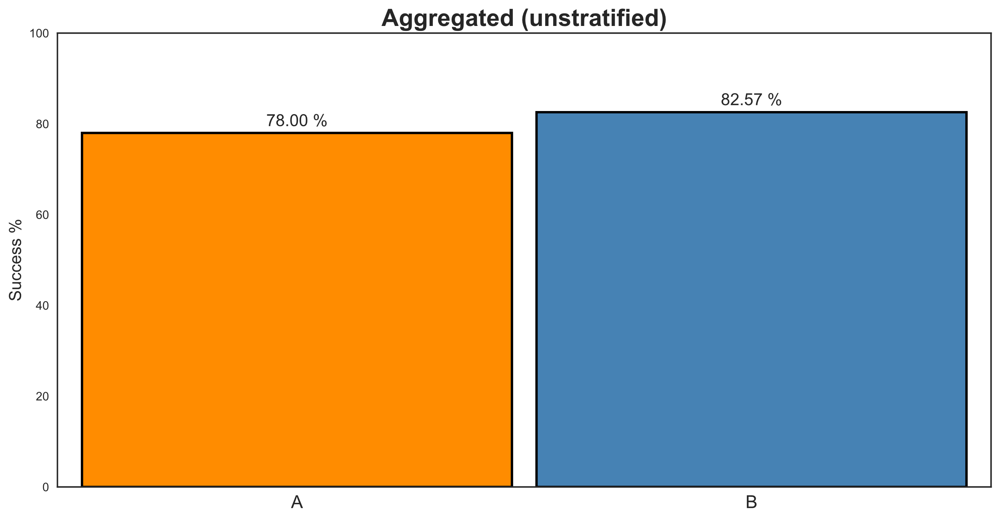
Simpson’s Paradox – Visualized
Width represents number of subjects
Notes:
Width has a meaning.

Slide 49
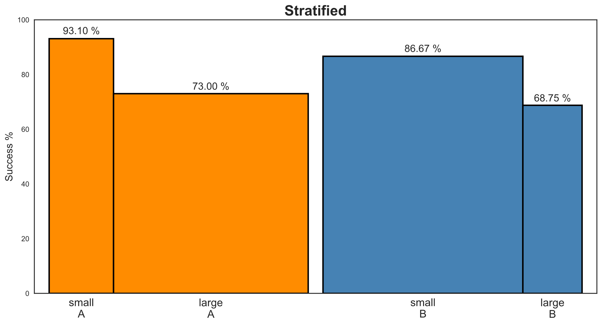
Simpson’s Paradox – Visualized

Slide 50
Simpson’s Paradox – Visualized
Place confounders next to each other

Slide 51
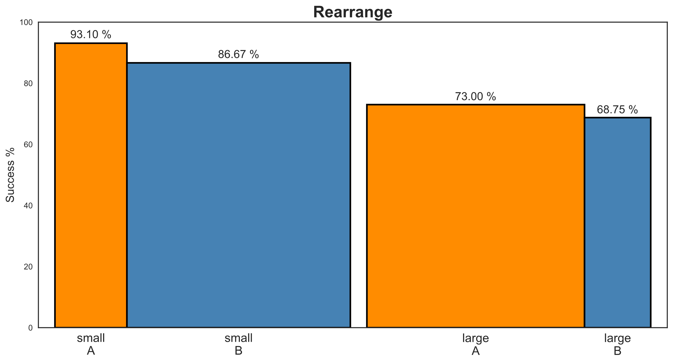
Simpson’s Paradox – Visualized

Slide 52
Simpson’s Paradox – Visualized
Notes:
A is better than B in both strata

Slide 53
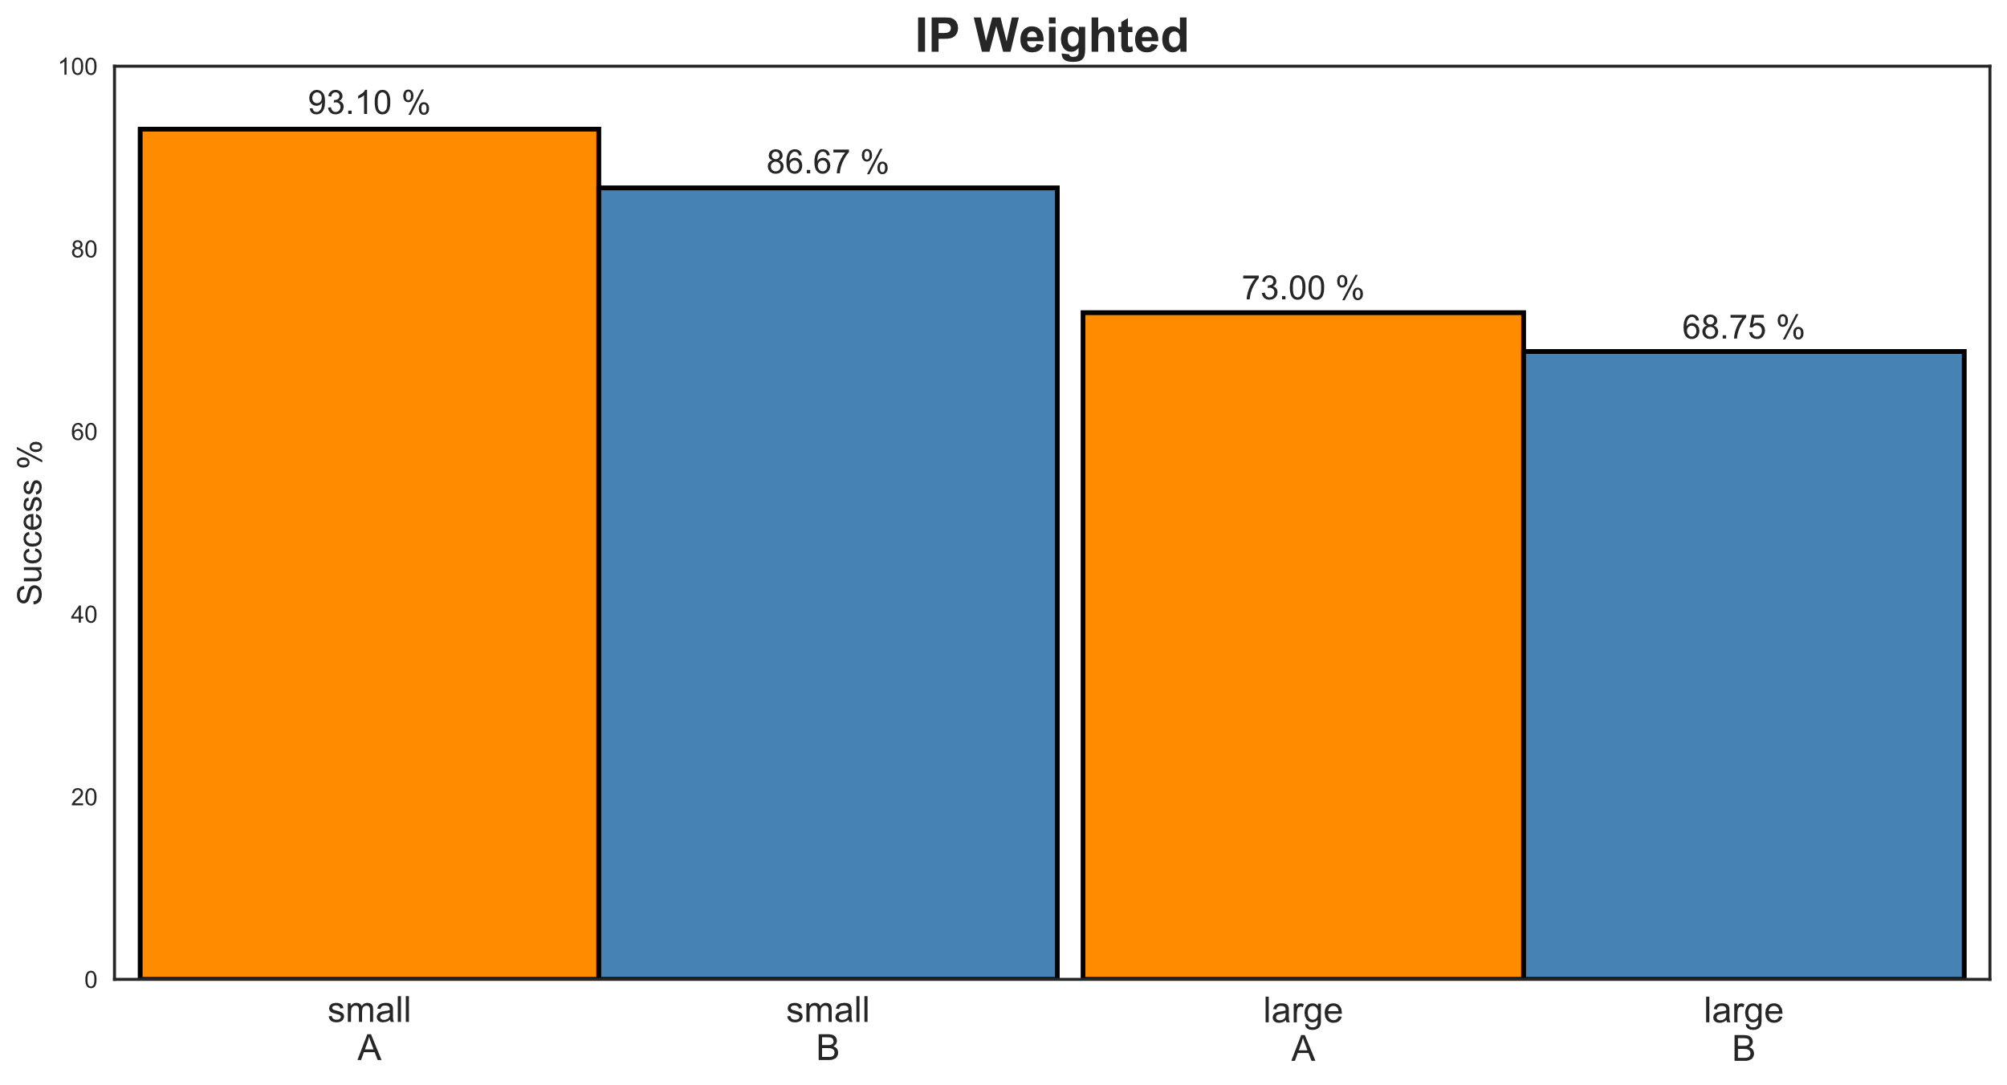
Simpson’s Paradox – Visualized
Equal width
Equal width

Slide 54
Simpson’s Paradox – Visualized
Equal width
Place treatments next to each other

Slide 55
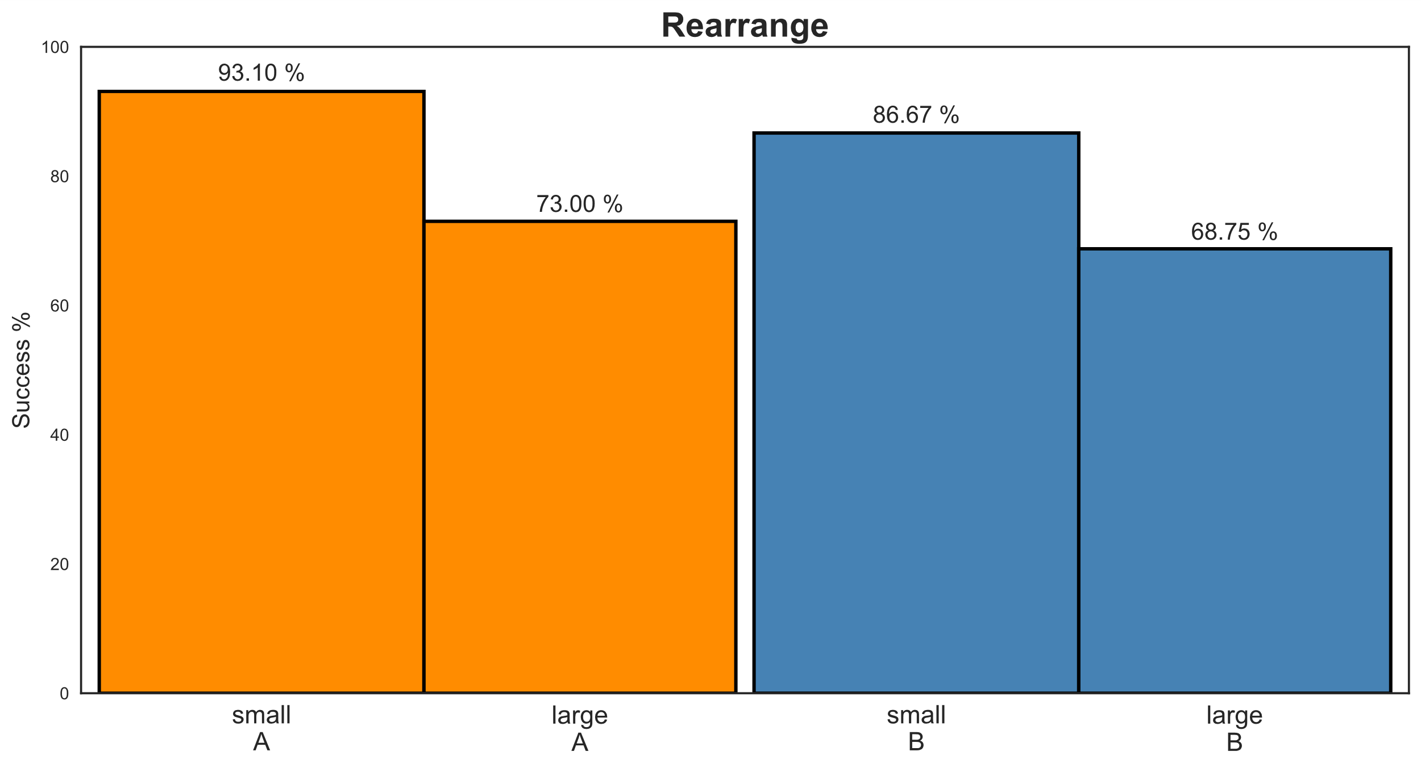
Simpson’s Paradox – Visualized

Slide 56
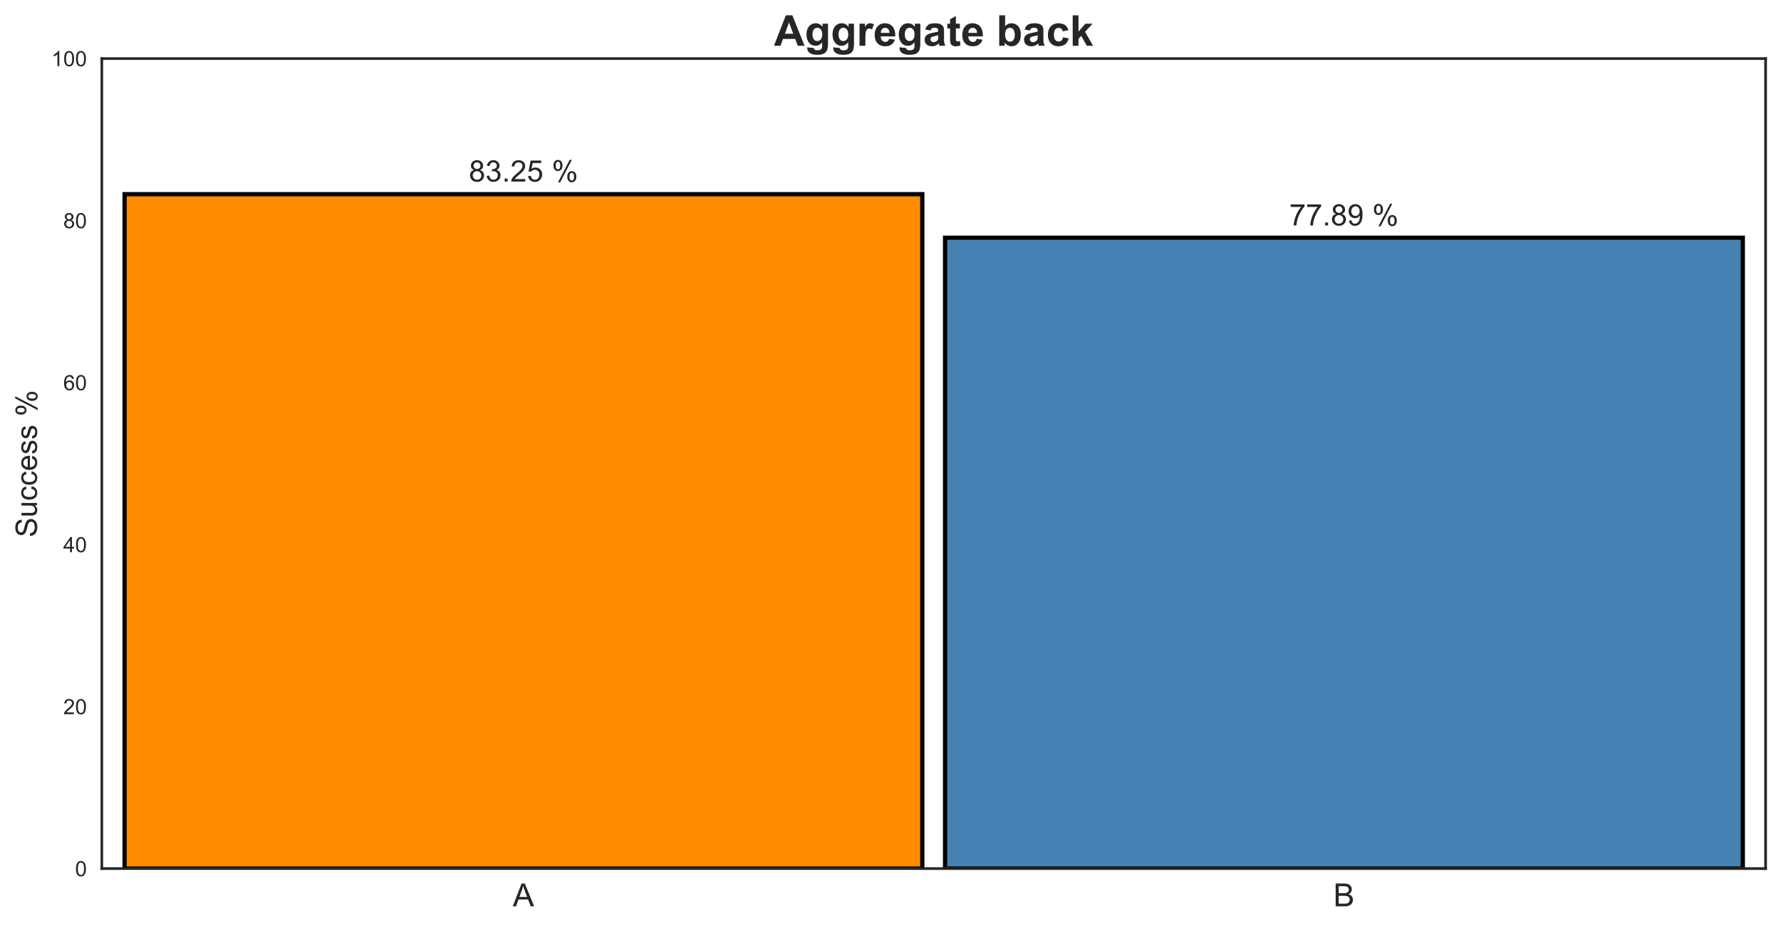
Simpson’s Paradox – Visualized
Notes:
And treatment A is indeed better in this pseudo population.

Slide 57
Simpson’s Paradox
IPW helped us to balance a biased sample.
What if we didn’t measure stone size?
causal sufficiency is impossible to prove.
Positivity-dimensionality tradeoff:
measure more variables can raise the probability that we measure a confounder, but reduce positivity (samples will diverge) [D’Amour 18’].
Watch-out: Measuring too many variables can sometimes increase variance or bias the estimation.
Notes:
Causal sufficiency – knowing you measured all needed variables.

Slide 58
Take-Home Messages
Data are dumb – associations are bidirectional as opposed to cause & effect.
That instrument measuring blood pressure is called sphygmomanometer.
Counterfactuals (=potential outcomes) – embrace the would haves.
RCTs are great but not always feasible.
So we try to emulate them from data.
Inferring causal effect from data is more of a thought process than a set of tools (i.e. it requires us to be willing to make assumptions).
… But you should also have the tools (Matching, IPW, many-many more…)
Inferring causal effect from data is possible
…But be careful and always stay critical.
Notes:
10. Model calibration?
11. Visualize whenever possible.
12. Slides are cheap make a tone out of them.

